Slide 1
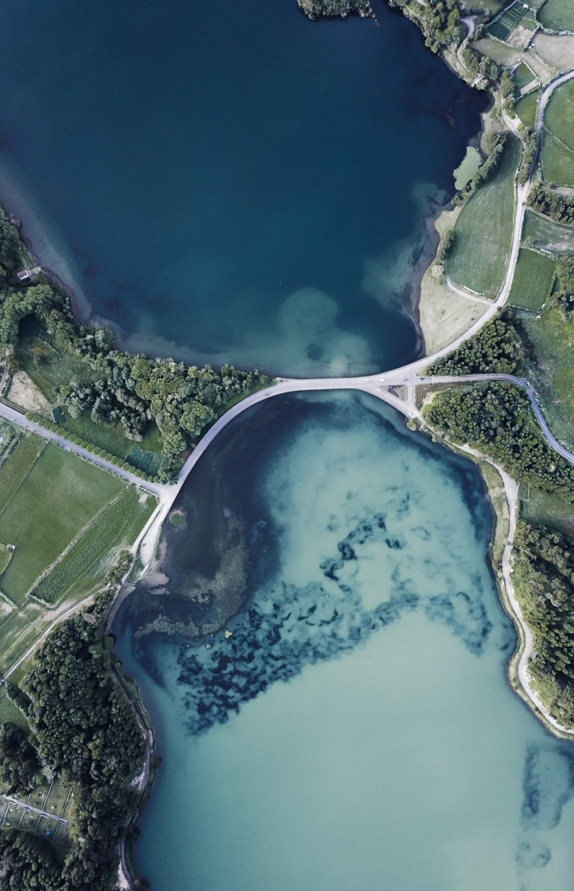

IoT-enabled SOFT sensor for chlorophyll-a concentration prediction using machine learning
Name: Palok Biswas
Matric Number: WOA180016
Supervisor: Dr. Zati Hakim Azizul Hasan
Department: Artificial Intelligence, FCSIT

Slide 2
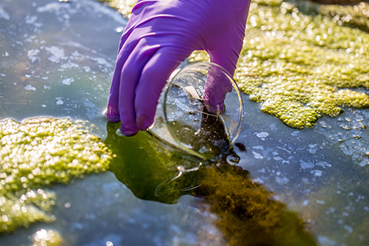
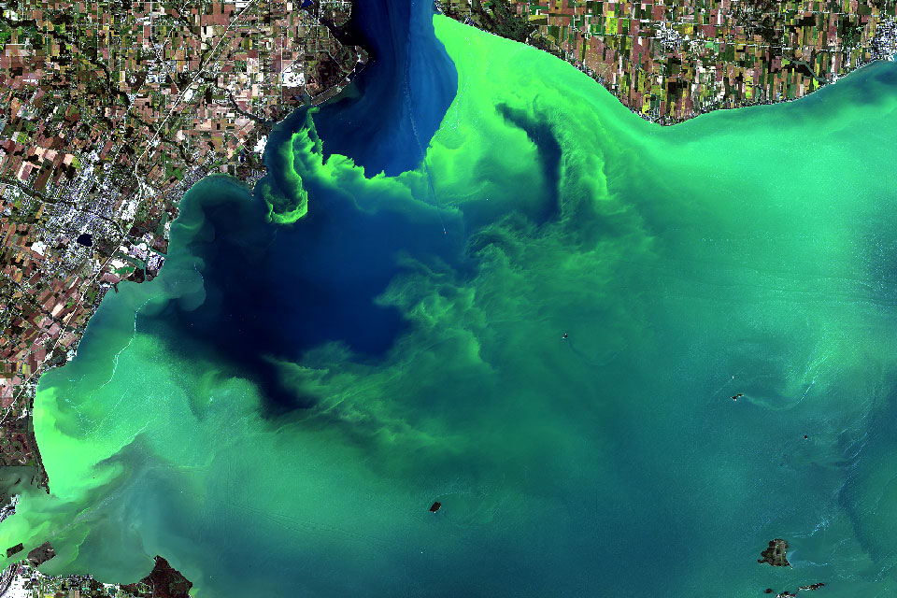
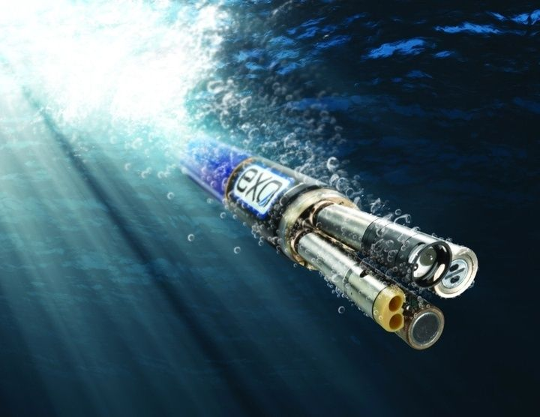
Background
About 60% of Malaysian lakes suffer from eutrophication
Eutrophication or algal bloom is caused by excessive organic nutrients (a by product of human activities)
For prevention, NAHRIM proposed continuous water sampling to detect degradation at early stages
Currently, water sampling is done manually, involving expedition with boats
Preferably done in-situ by dipping hand-held sonde into water
Common 5 parameters to sample include pH, temperature, conductivity, turbidity and dissolve oxygen (Koparan, 2018)
For eutrophication, usually test in the lab for Chlorophyll-a
Grab Sampling
Algal Bloom
YSI EXO Sonde

Slide 3
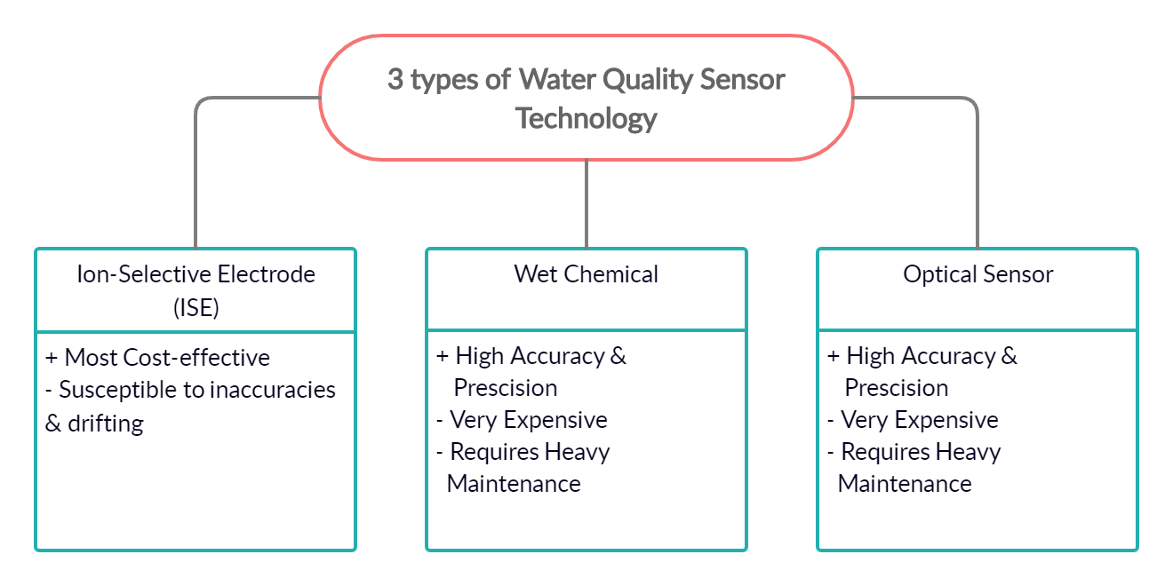
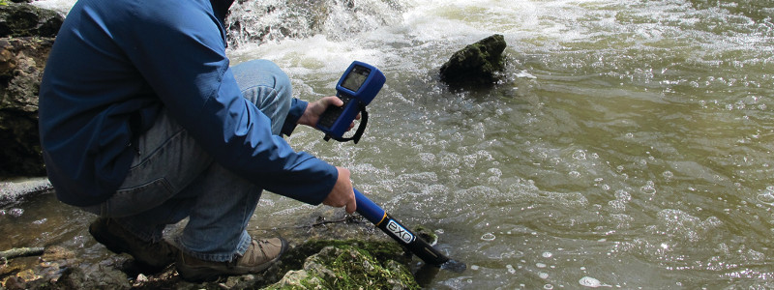
BACKGROUND
Often these in situ sensors are expensive and not IoT-enabled
Data is recorded in USB and manually transferred from sonde to another platform for processing
Not feasible for continuous real-time monitoring
State-of-the-art water sampling (YSI EXO1 Sonde)

Slide 4
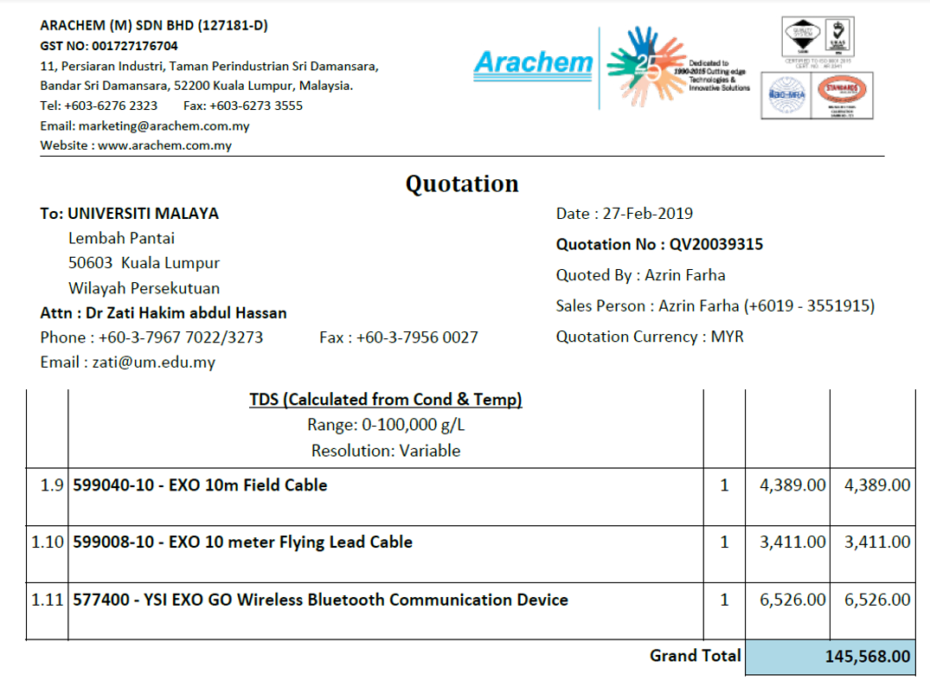
MOTIVATION
As a rough guideline on the cost, a normal sonde with 5 common water parameters i.e. pH, temperature, conductivity, turbidity and dissolve oxygen costs RM41,000
To include IoT-enabled features, require another RM76,000
Sample Quotation for EXO GO IoT-enabled multiparameter sonde, 2019

Slide 5
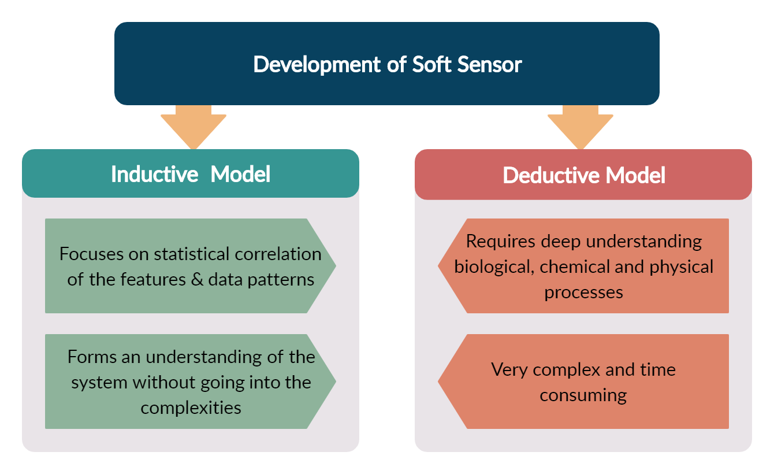
MOTIVATION
Development of chl-a soft sensor
It is possible to predict the parameter based on other available water quality parameters using a machine learning model and is termed a soft sensor (Castrillo & García, 2020).
Algorithms like ANN is a good example of inductive modelling that can predict parameters like Chlorophyll-a (Tian et al., 2017) from 5 basic water parameters i.e. pH, temperature, conductivity, turbidity and DO

Slide 6
Literature Review
Chlorophyll-A Prediction
Reference | Aim | Algorithm | Findings | Gap
Huo et al. (2013) | Eutrophication (Algal bloom) prediction and tropic state of the water body is determined by predicting chlorophyll-a which is the prime indicator for eutrophication | Back Propagation NN | Nonlinear relationship between Chl-a and input parameters. Requires more than 5 input parameters (check) | Gap1: requires more than 5 basic parameters Gap2: no booster using DO time-series data
Zhang et al. (2016) |  | Deep Belief Network | Dependent on meteorological, hydrological and other biochemical processes
Tian et al. (2017) |  | Back Propagation NN | Temp, TSS, TP & NP influence Chl-a and Transparency
Yi et al. (2018) |  | Extreme Learning Model | Region of rivers have different . Predictive models are specific to a waterbody
Mamun et al. (2020) |  | Support Vector Machine | Rainfall, solar radiation
Jimeno-Sáez et al. (2020) |  | Support Vector Regression | Chl-a data is a non-stationary time series process which makes prediction difficult

Slide 7
Literature Review
WQI Prediction
Reference | Aim | Algorithm | Findings | Gap
Camejo et al. (2013) | Water Quality is assessed to estimate the WQI and also water is also classified according to the water quality standards | k-Nearest Neighbour, | Deep learning outperforms other models like kNN & SVM | Gap3: requires expensive sonde or lab-testing (Add more references)
Yan et al. (2017) |  | Extreme Learning Machine
Shafi et al. (2018) |  | Deep Neural Network
Ahmed et al. (2019) |  | Gradient Boosting & Polynomial Regression
Li et al. (2019) |  | Hybrid Support Vector Regression

Slide 8
Literature Review
Parameter Retrieval
Reference | Aim | Algorithm | Findings | Gap
Keller et al. (2018) | Retrieved certain water quality parameters that cannot be measured in situ in order to enable instantaneous remote sensing | ANN, SVM, Extremely Randomized trees (ET), | Neural Networks are superior when it comes to parameter retrieval compared to other ML models | Satellite images are not available in cloudy and dusty weather
Ruescas et al. (2018) |  | Random Forest Regression, Gaussian Process Regression |  | Hyperspectral or Multispectral radiometers are very expensive
Hafeez et al. (2019) |  | ANN
Shehhi & Kaya (2020) |  | Regression & Neural Network (Nonlinear Auto Regressive)

Slide 9
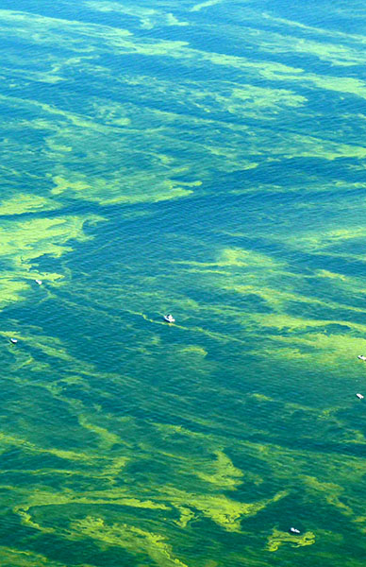
Problem statement
In-situ sampling is preferred for continuous real-time monitoring of water quality but there is no cost-effective sensor for chlorophyll-a
Chlorophyll-a concentration can be predicted using machine learning models with 5 basic water parameters; pH, temperature, conductivity, turbidity and DO
Additionally the time series method can complement the ML model result using (DO, .. , )in predicting Chlorophyll-a concentration.
Hypothetically, IoT-enabled sensor will be able to effectively model chlorophyll-a concentration value (mg/L) to determine eutrophication level at lakes. Ensemble/ML models/Timeseries (RNN).

Slide 10
RESEARCH MAPPING
Research Questions | Research Objectives | Research Methodology | Research Outcome
What are the various methods and core parameters for measuring chl-a in lake water? | To study different monitoring methods for efficient lake water sampling and parameters to accurately predict Chlorophyll-a | Systematic literature review | Findings on the performance of existing approaches Core parameters for water quality monitoring and Chlorophyll-a prediction
How can chl-a concentration be predicted using 5 basic parameters? | To develop an ensemble machine learning model for chl-a concentration prediction based on 5 basic parameters and timeseries data. | Model Development | An ensemble model for Chl-a concentration prediction based on ML (ML/DL/RNN)
How to reduce real-time monitoring cost for chl-a prediction? | To develop an IoT monitoring system for chl-a prediction | 1. System Development | 1. An IoT-enabled sensor system for chl-a concentration prediction
How do timeseries and ML perform in predicting chl-a concentration? | To test the ensemble model performance | Experiment Validating & fine-tuning | 1. Results of performance on Chl-a concentration prediction
Your company name

Slide 11
METHODOLOGY
Chl-a soft sensor development
Module 1: (addresses objective 1)
Machine Learning model for 5 basic Parameter
DO
Ph
Temp
Turbidity
Electrical Conductivity
Time series model
DO
Module 2: (addresses objective 2)
IoT sensor system development

Slide 12
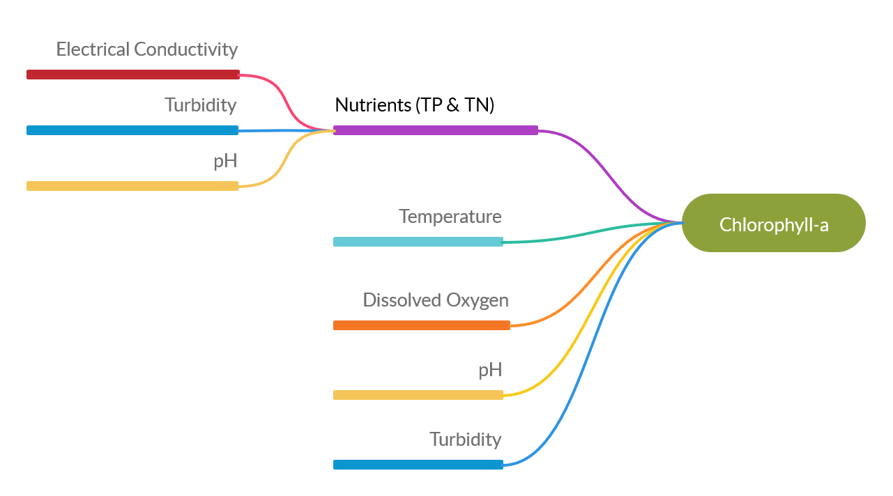
Module -1: CORRELATION MAP (PUT ML architecture after this)
Studies showed that Chlorophyll-a is significantly correlated with temperature, DO, pH, Transparency, Total Suspended Solids (TSS) and nutrients namely, total nitrogen (TN) and total phosphorus (TP) (Huo et al. 2013; Mamun et al. 2020).
These nutrients (Phosphorus and Nitrogen compounds) in turn are correlated with Electrical Conductivity, Turbidity and pH.

Slide 13
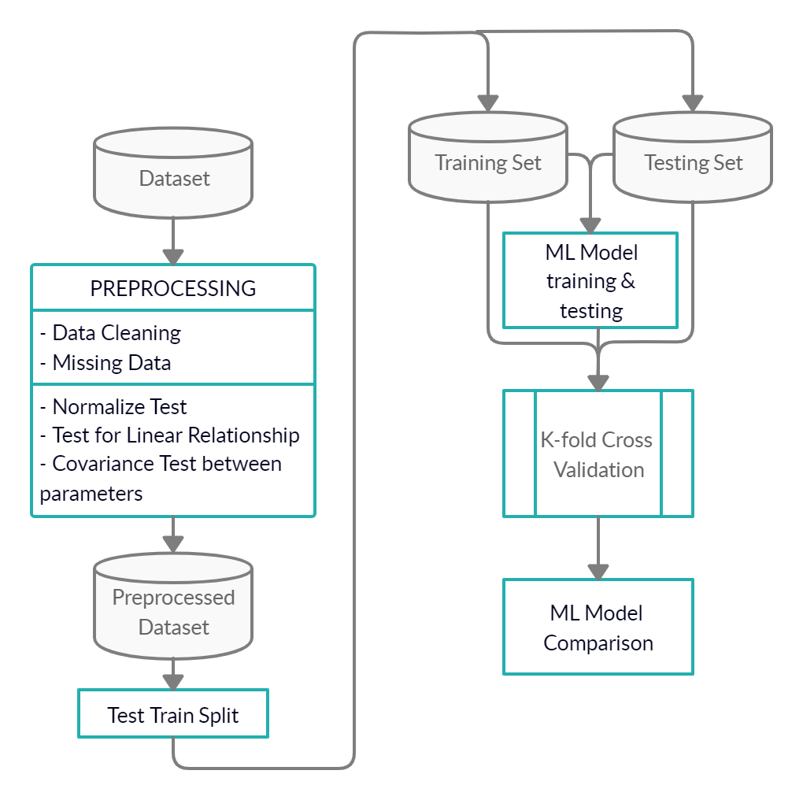
METHODOLOGY (MODULE-1)
Machine learning model for chlorophyll-a prediction
The machine learning models selected for this study (SVM, SVR, Deep Learning, ELM, RF and ANN)
to assess which model performs best, k-fold cross validation test will be used

Slide 14
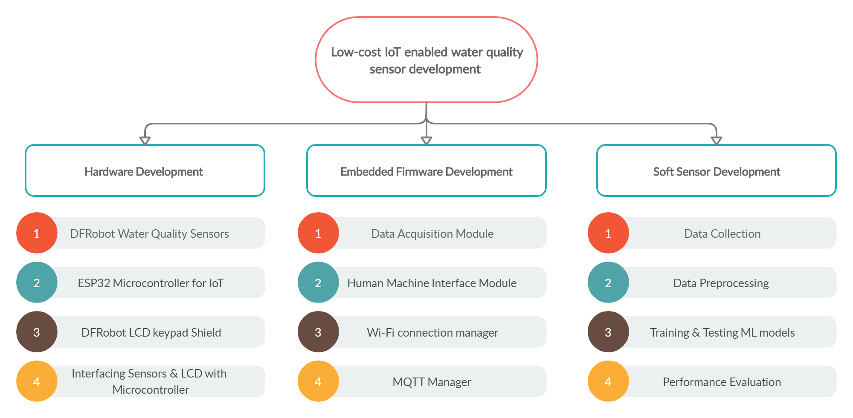
Module 2 methodology/overview

Slide 15
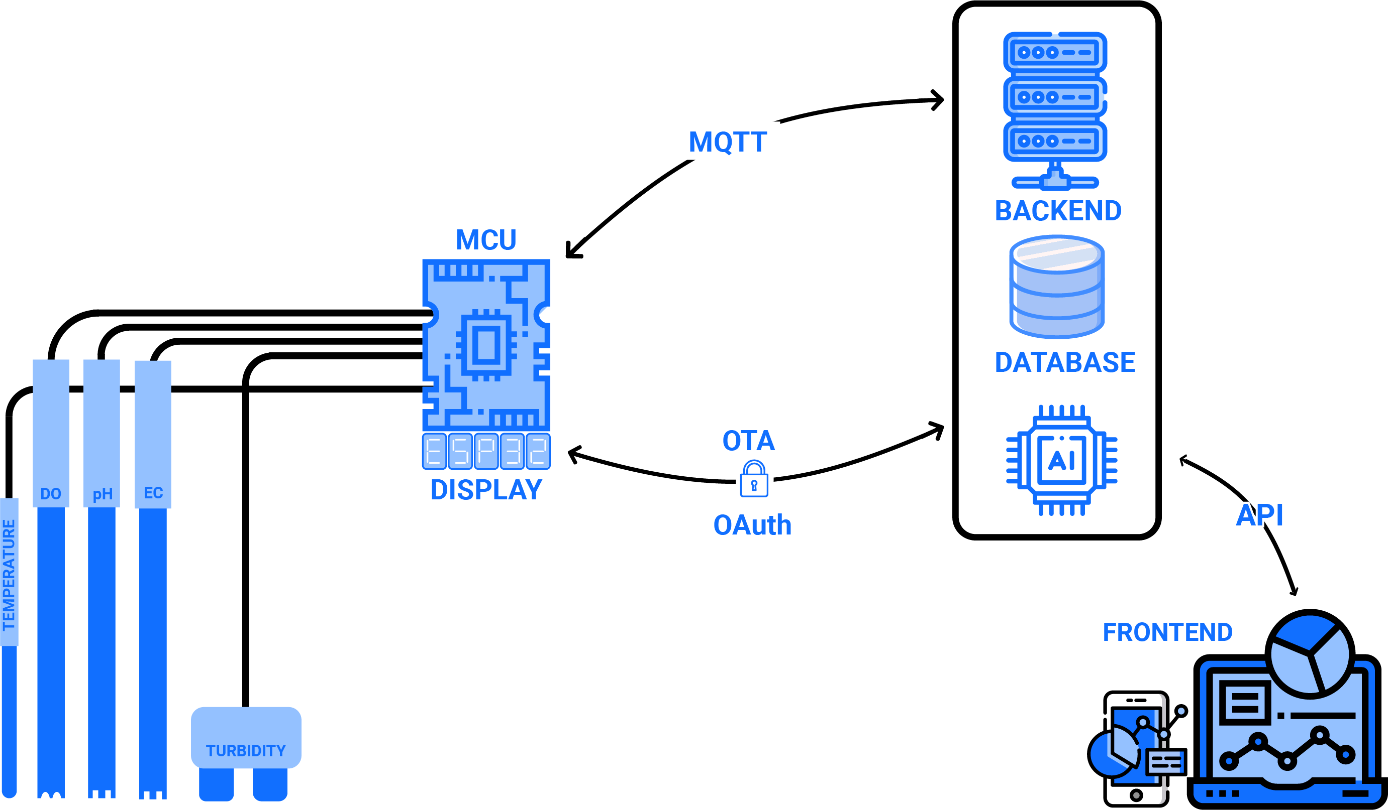
Module-2

Slide 16
METHODOLOGY
Development of low-cost IoT enabled multiparameter sensor (5 WQ parameters)
Soft Sensor
Develop chlorophyll-a soft sensor
Testing and Evaluation

Slide 17
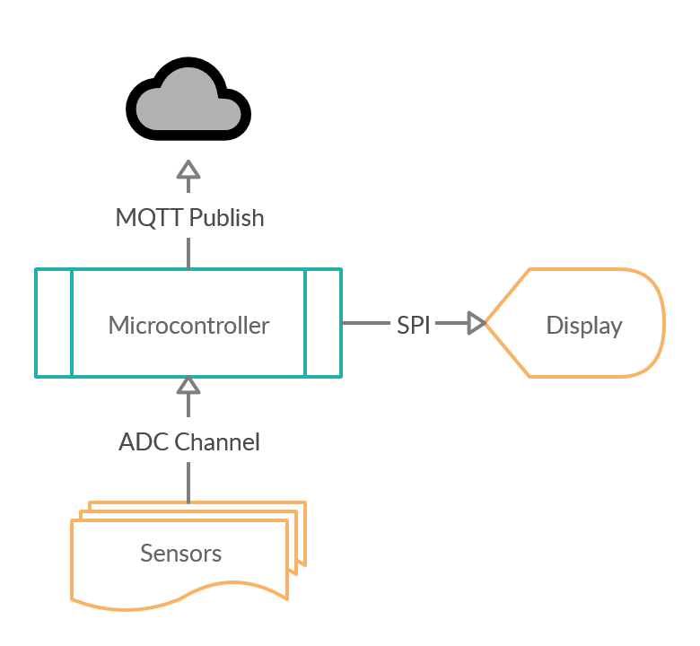
MODULE-2
Hardware Development (Completed)

Slide 18
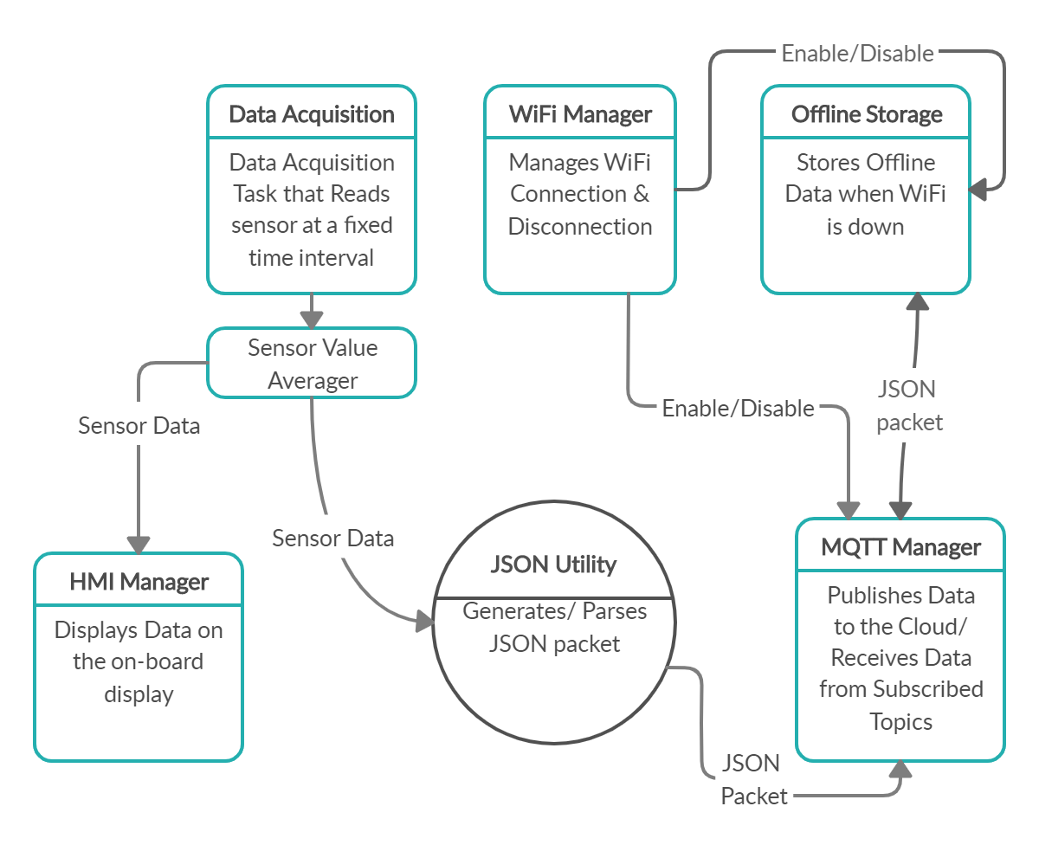
Module 2
Firmware Development (Completed)

Slide 19
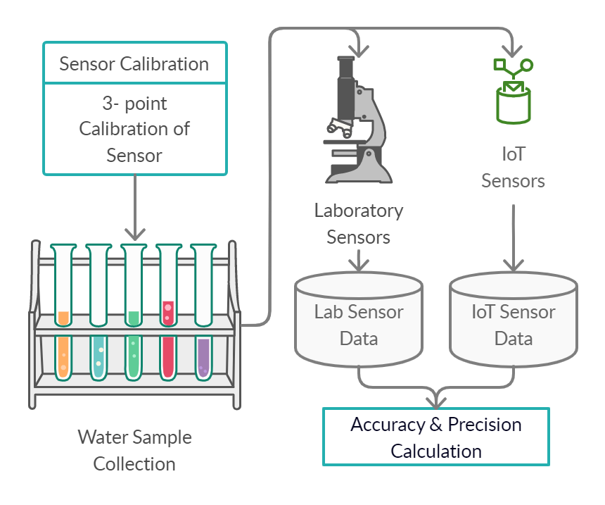
METHODOLOGY (not needed)
Sensor calibration (on-going)
Calibrate using standard solutions for each parameters
Measure real water samples with IoT Sensor & Lab sensor
Evaluate the performance of the IoT sensor against lab sensor data

Slide 20
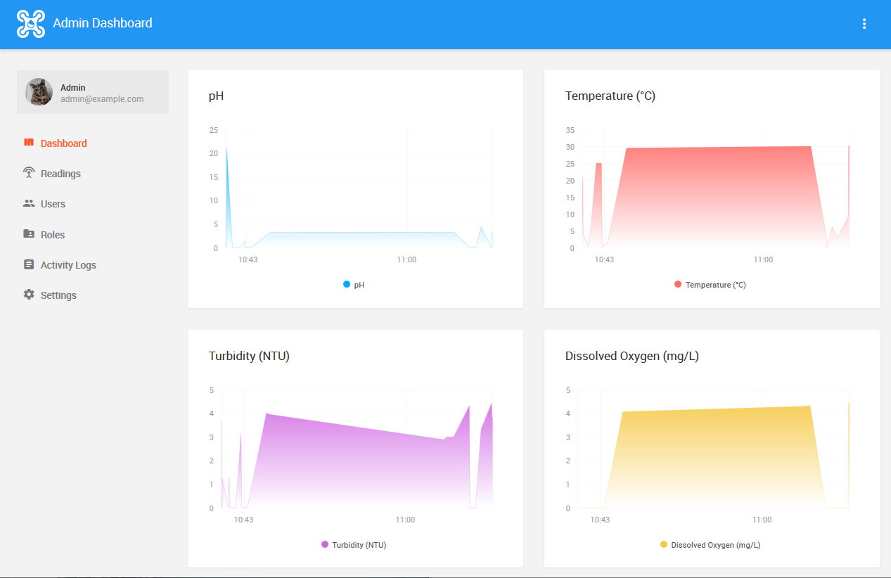
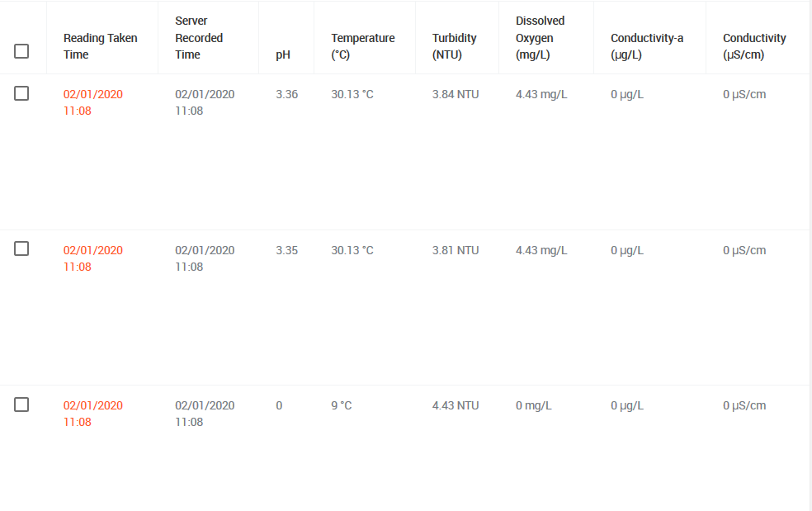
DATA VISUALIZATION

Slide 21
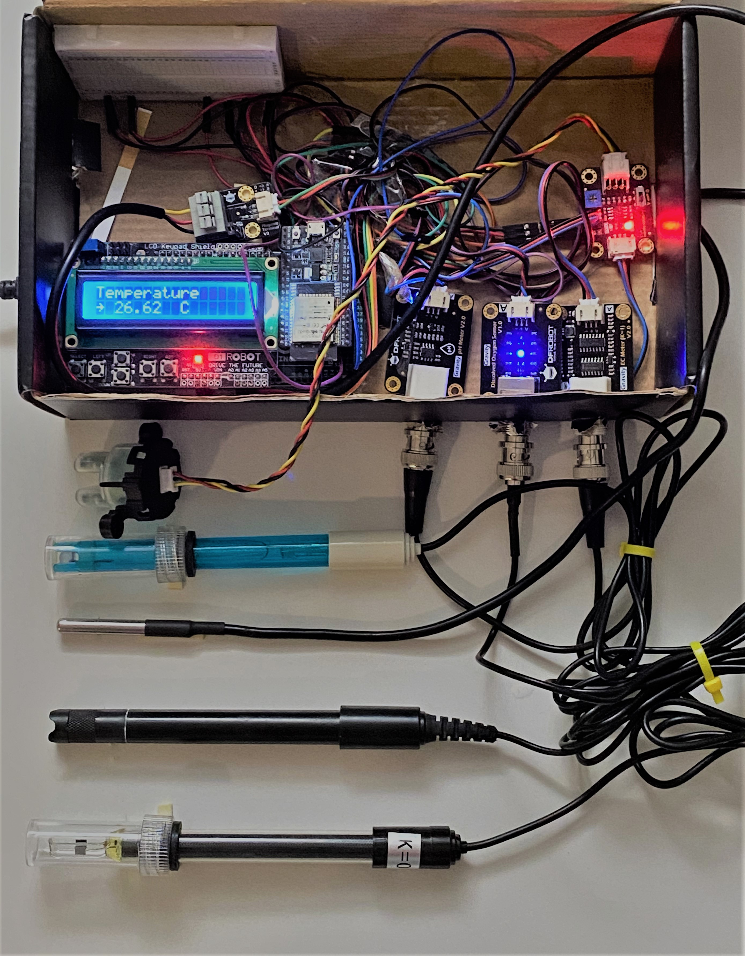
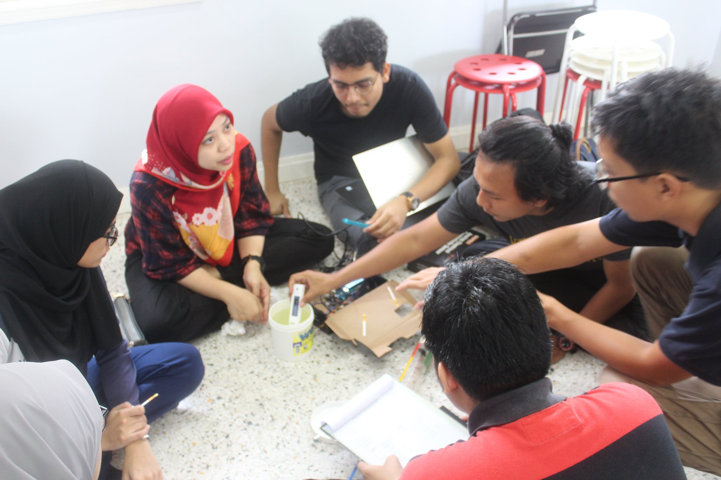
USER ACCEPTANCE TESTING
Testing and evaluation
User acceptance evaluation by project impact partner, Water Warriors (UM)

Slide 22
CURRENT PROGRESS & ACHIEVEMENT
Photo of sensor and dashboard
2019 NCKU Maker Festival and International Student Innovation Competition, Taiwan
Won 3rd place for earlier prototype of the IoT-enabled low-cost water quality device

Slide 23
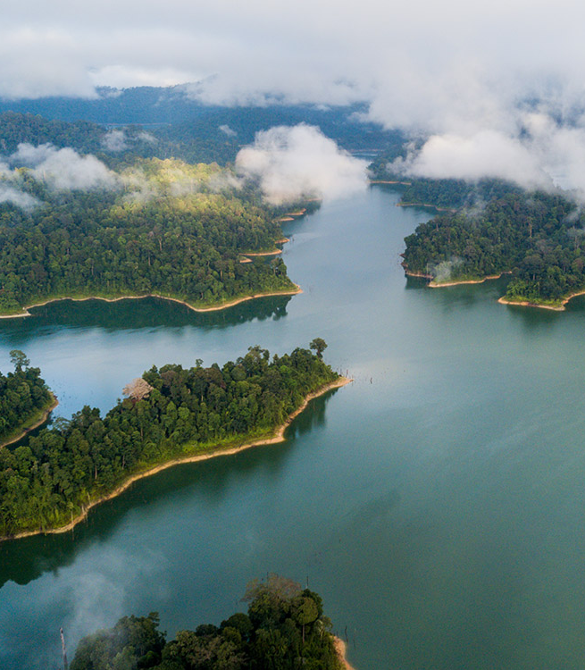
CHALLENGES
Acquisition of time series data for Malaysian lakes
Sv working to get data by DOE through collaborator NAHRIM

Slide 24
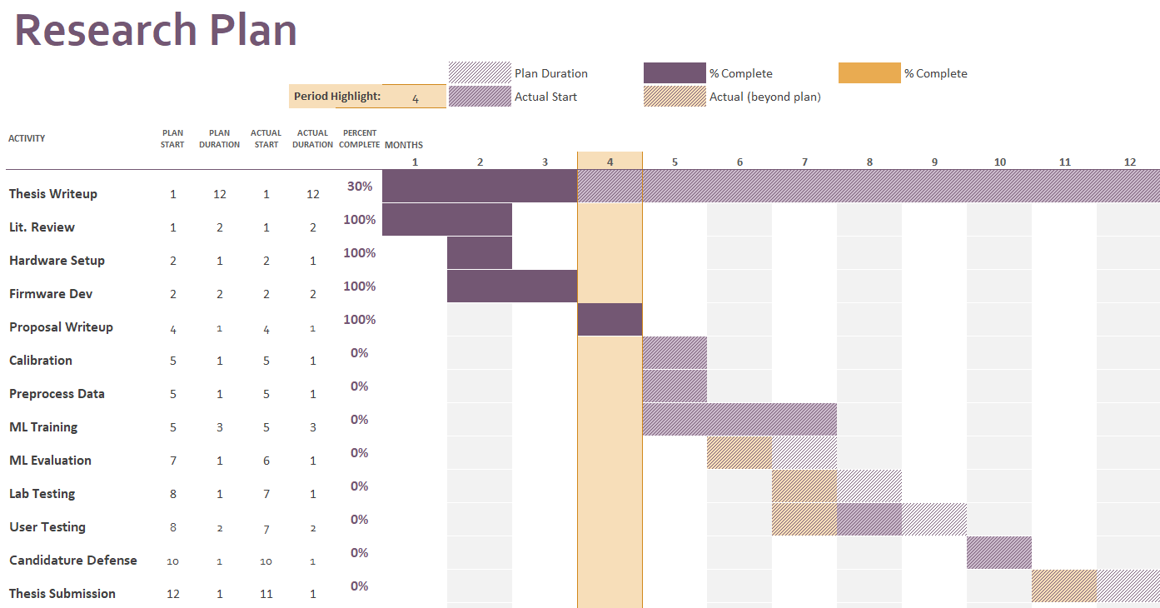

Slide 25

CONCLUSION
This research contributes to the improvement of water quality monitoring of water bodies (lakes) in Malaysia.
Specifically, it addresses the mitigation measures under the Environmental Quality Act (1974) and more generally, the National Water Resources Policy (2012).
It is also related to the SDG6 aspects in the upcoming Rancangan Malaysia ke-12, especially on integrated water resource management

